Slide 1
Visualization of Covid-19 Cases in Kenya by County
By Maria Ogamba

Slide 2
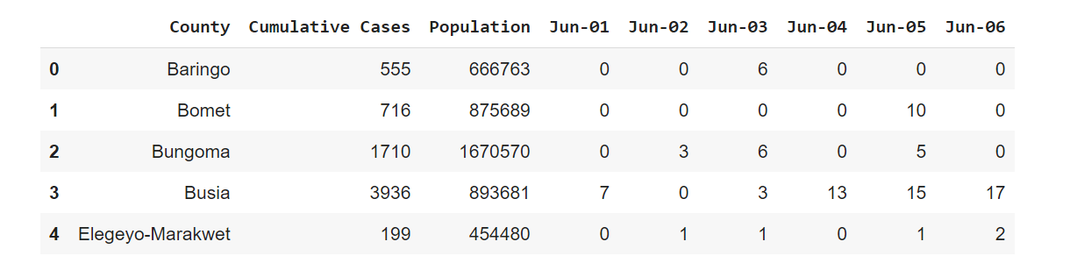
Dataset Being Used
This is a snippet of how the dataset looks like.

Slide 3
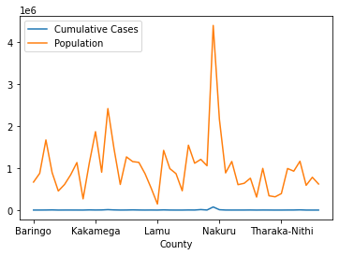
Line Graph of Cumulative Cases and Population
This line graph provides a good overview of the data and can be used to detect general trends.
From the figure we can see that the counties with higher population have a higher number of COVID-19 cases.

Slide 4
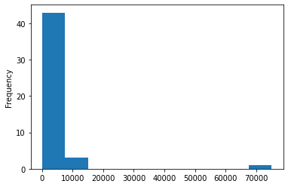
Histogram of Cumulative Cases of the Counties
The next two plots will give a general overview of the number of cases in the dataset and to examine the outliers.
The histogram peaks on the left below 10,000. The tail stretches far to the right and suggests that there is a county with a significant number of cases beyond the others, that is, Nairobi County.

Slide 5
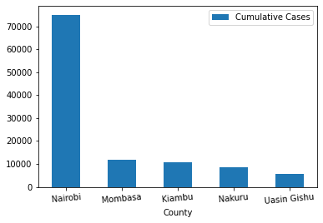
Bar Graph of the Top 5 Counties
This plot shows that the number of cases in Nairobi County is more than 60,000 higher than the rest.
The number of cases for the second- through fifth-place counties are relatively close to one another.

Slide 6
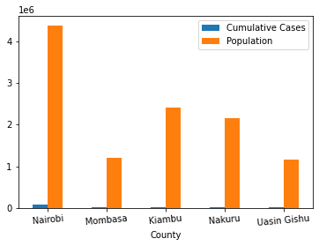
Bar Graph of Top 5 Counties
This bar graph compares the population against the cumulative cases of the top 5 counties with the highest number of cases.
Nairobi County, with the highest population, has the highest number of cases.

Slide 7
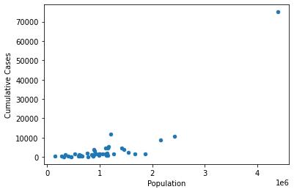
Scatter Plot of Population vs Cumulative Cases
In this figure, we can conclude that the counties with higher population have a higher number of cases, and that the two columns have a correlation.
On the other hand, this cannot be proof that the correlation of the two will imply causation, that is, an increase in population will cause an increase in the number of cases.

Slide 8
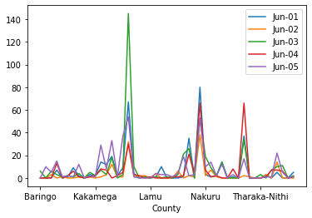
Line Graph of Recorded Cases between June 1st to June 5th
This line graph shows the number of recorded cases in each county from June 1st 2021 to June 5th 2021. There was a great increase of the number of cases in Kisumu as compared to the other counties.
This could be connected to the campaigns that were conducted during this week, and the week before June 1st.

Slide 9
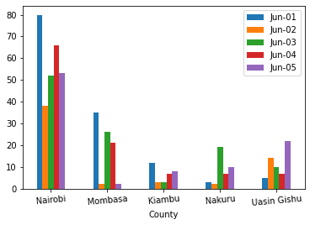
Bar Graph of Recorded Cases between June 1st to June 5th
In this graph, we can compare the number of cases recorded between June 1st 2021 and June 5th 2021 among the top 5 counties with the highest number of cumulative cases.
If we compare this graph with the line graph in the previous slide, we can see that Kisumu County has not reached the top 5 despite having a great increase in the number of cases recorded on June 1st to June 5th.

Slide 10
Tools and References
Python with Pandas and Matplotlib.
Microsoft Excel
Google Colaboratory
2019 Kenya Population and Housing Census Volume I: Population by County and Sub-County. (n.d.). Kenya National Bureau of Statistics. Retrieved June 3, 2021, from https://www.knbs.or.ke/?wpdmpro=2019-kenya-population-and-housing-census-volume-i-population-by-county-and-sub-county
COVID-19-Outbreak-in-Kenya-Daily-Report-SITREP-940-22-April-2021.pdf. (n.d.). Retrieved June 3, 2021, from https://www.health.go.ke/wp-content/uploads/2021/04/COVID-19-Outbreak-in-Kenya-Daily-Report-SITREP-940-22-April-2021.pdf
Kenya: Cumulative coronavirus cases 2021, by county. (n.d.). Statista. Retrieved June 7, 2021, from https://www.statista.com/statistics/1136519/cumulative-coronavirus-cases-in-kenya-by-county/
Python, R. (n.d.). Plot With Pandas: Python Data Visualization for Beginners – Real Python. Retrieved June 7, 2021, from https://realpython.com/pandas-plot-python/

